Slide 1
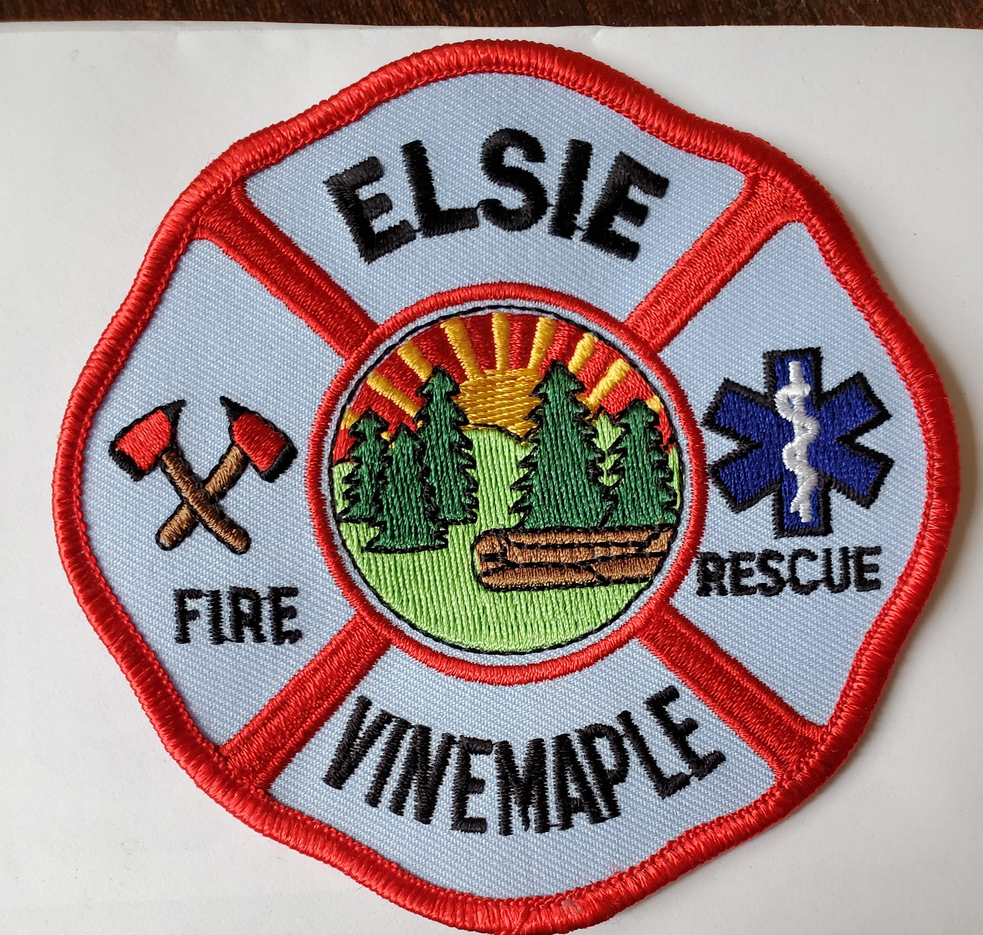
EVRFPD Special Board Meeting
December 7, 2023

Slide 2
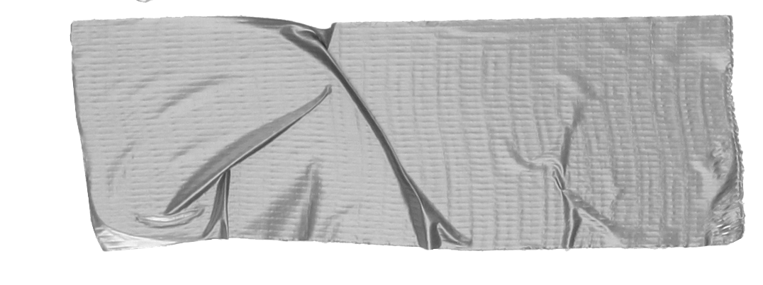

Agenda
Approval of November Minutes - comments, edits?
Clarification of Roles and Responsibilities (continued on next slide)

Slide 3
Clarifying Roles and Responsibilities
Station 2
  GOAL: For Board to take over management of Station 2.
  Tasks assigned at last meeting:
Mike checking distance requirements for flagpole
Mike and Staciy work on plot plan
Tracking expenditures and records for Station 2
Project mgmt done by Board, carried out by Mike.
  Current status
    Mike completed plot plan and confirmed flagpole is ok.
    Mike got original building plans, foundation calculations, and permits from County and sent to Deidra.
    MIke has also moved ahead on some other items (planning some work on small pump house, going to County for information on signage requirements and use of creek as water source, etc)
    Mike has been acting as point person with Deidra, rather than going through Board, for numerous things.
GREAT PROGRESS SO FAR – GOOD JOB, TEAM!!

Slide 4
Clarifying Roles and Responsibilities (cont)
d. Going forward:
      The Board will act as point person with Deidra. All interactions
will go directly between Deidra and the Board.
Following from that, the Board will let Mike know
what needs to be done with Station 2.
      Deidra will be point person with the County offices.
      There will be no demolition, and no further work of any kind
on Station 2 without a directive from Deidra to the Board,
who will then tell Mike if there is anything he needs to do.
This includes the small pump house referred to in Sunday email.
e. Action Items
      TJ and I will receive email from Deidra.
      I will forward docs to other Board members as I get them.
      TJ will meet Deidra at Station 2 if needed, or designate an alternate Board member.
      Mike will continue to gather and organize Station 2 records (permits, docs, financial records, etc.) so we can work toward collating them into binders.
      Mike will work on cleaning out Station 2, per Deidra’s request. Would he like help from any Board members with that?
We are a team! Let’s support each other and work together to utilize all of us as resources

Slide 5
Clarifying Roles and Responsibilities
2. Grounds Maintenance Follow Up
  Recap:
    Board voted in November 2022 to establish contract.
    Board voted in December 2022 to award to George
    Mike said last month he had not paid George
  Set up time tomorrow to meet to write and sign check.

